Slide 1


DSC 640 – Airline Safety
Pushkar Chougule
T-301

Slide 2
Airline Safety - Fact Checks parameters
Fatalities comparison - Air Travel vs. Road Travel in US (1994 – 2019)
U.S. Fatality rates per 100 million miles of travel Air travel vs. Road travel (1994 – 2019)
World Airline fatalities snapshot (1985 – 2014)
World Airline incidents and fatal accidents snapshot (1985 – 2014)
Overall Fatalities By Modes of Transport in US (2019)
Revenue Passenger Miles – Steady and Notable increases - US and International (2002 – 2019)
Operating Revenue – US Airlines (2000 – 2019)
World Airlines Traffic – Steady Increase (1984 – 2019)

Slide 3
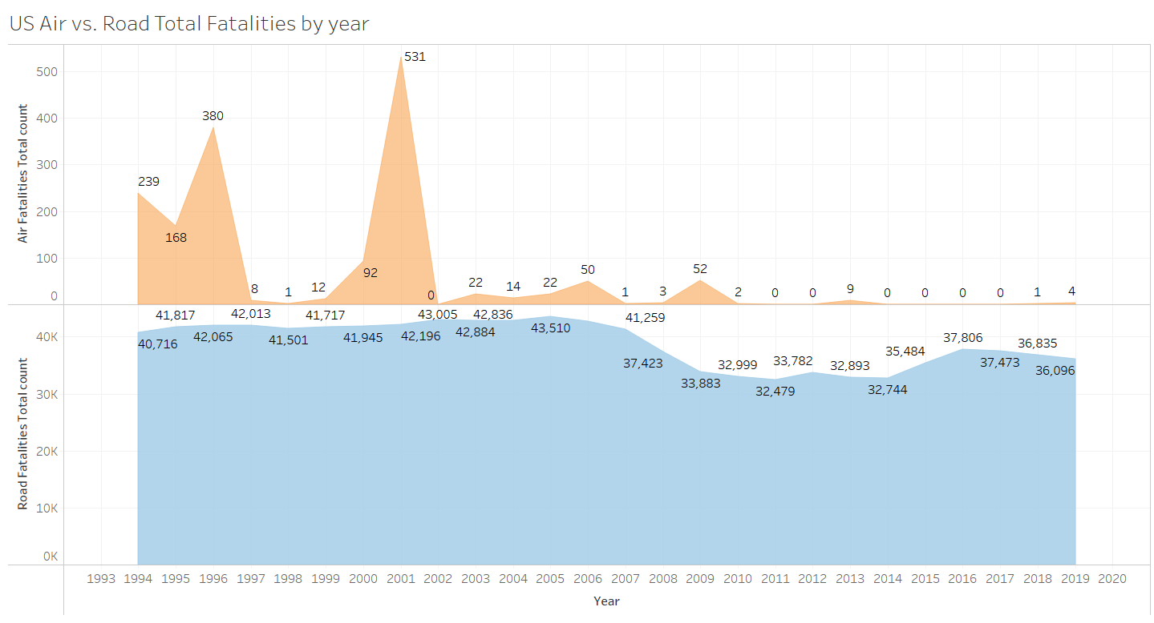

Slide 4
Fatalities comparison - Air Travel vs. Road Travel in US (1994 – 2019)
Much lower fatalities for Air travel in U.S.
The peak of 531 back in 2001
The declining trajectory ever since and near 0 counts in recent years until 2019
Fairly higher fatalities for Road travel in U.S.
The peak of 43510 back in 2005
Still lingering around 36,000+ up until 2019

Slide 5
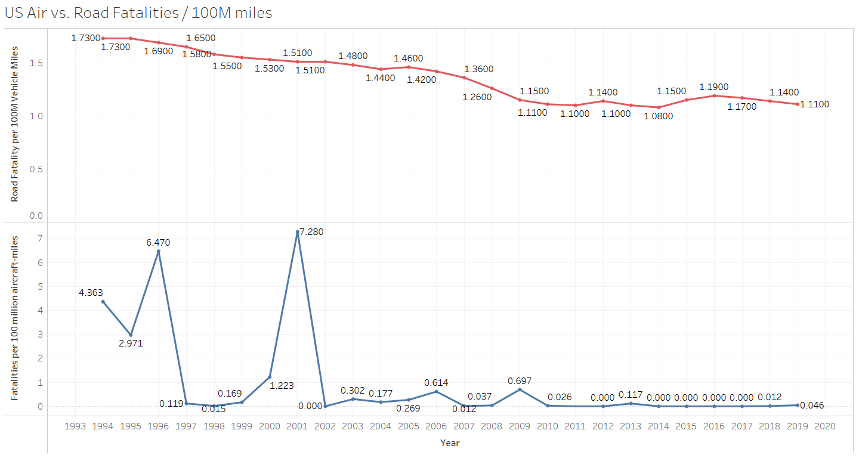

Slide 6
U.S. Fatality rates per 100 million miles of travel Air Fatalities vs. Road fatalities
Much lower fatalities rates per 100 millions of aircraft miles for Air travel in U.S.
The peak of 7.28 back in 2001
The declining trajectory ever since and near 0 rate in recent years 2019
Relatively higher fatalities per 100 millions vehicle miles for Road travel in U.S.
The peak of 1.73 back in 1994
Has only managed to come down up to 1.11 until 2019
~99.45%
~35.84%

Slide 7
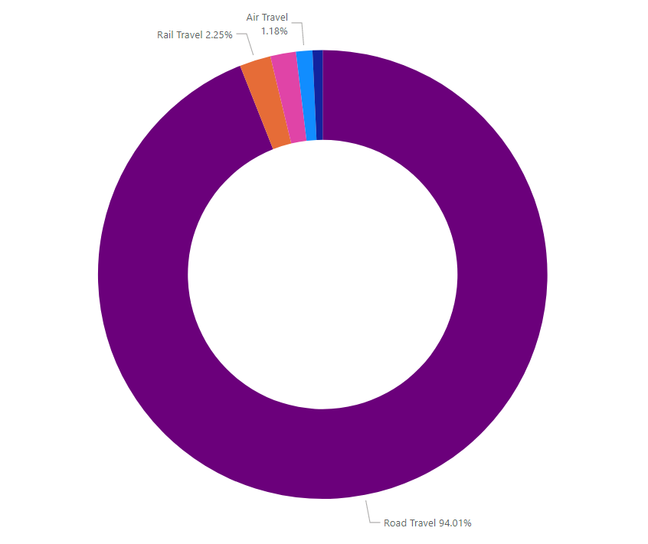
Overall Fatalities by Modes of Travel – US (2019)

Slide 8
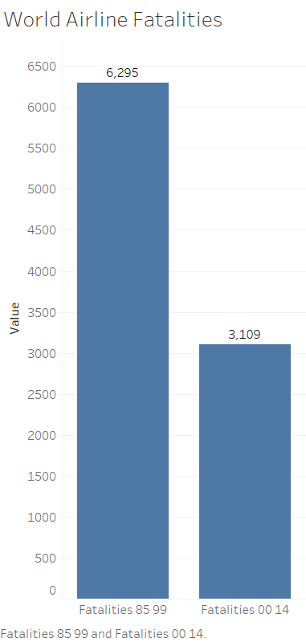
World-wide Airlines Fatalities – Reduction in fatalities by 50% (1985 – 1999 vs. 2000 – 2014)
~ 50%

Slide 9
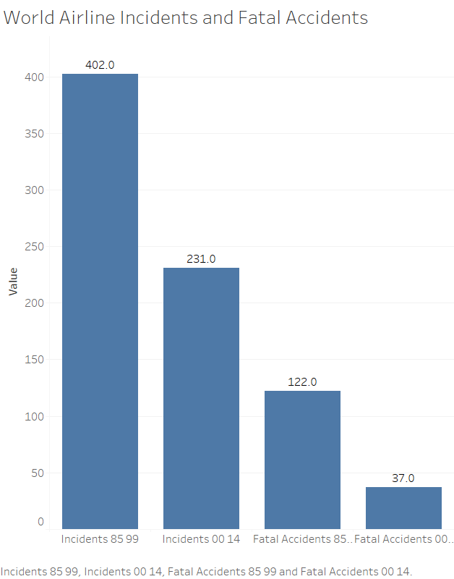
World-wide Airlines Incidents and Fatal Accidents – Huge Reductions (1985 – 1999 vs. 2000 – 2014)
~ 42%
~ 70%

Slide 10
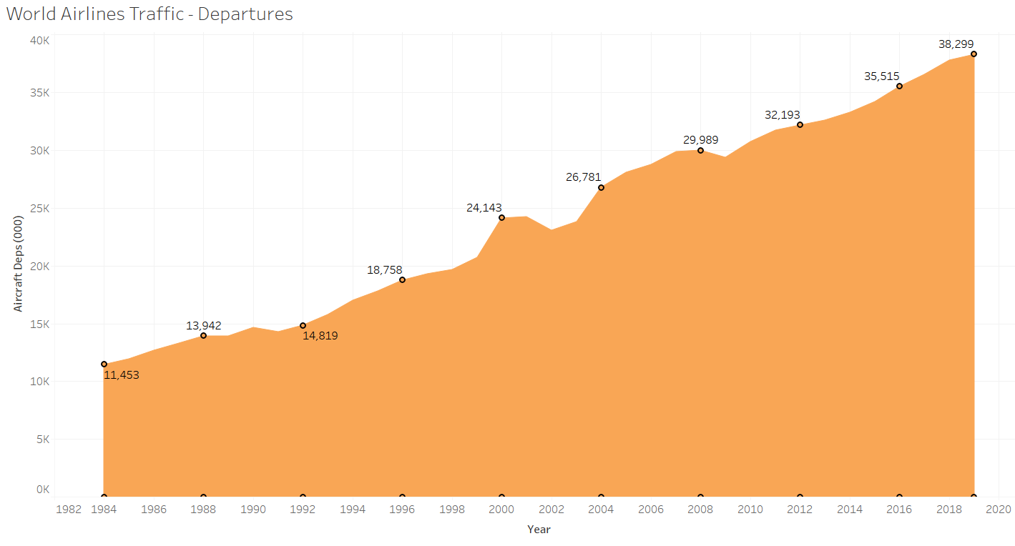
World Airlines Traffic - Steady increase (1984 – 2019)
More than 3-fold increase

Slide 11
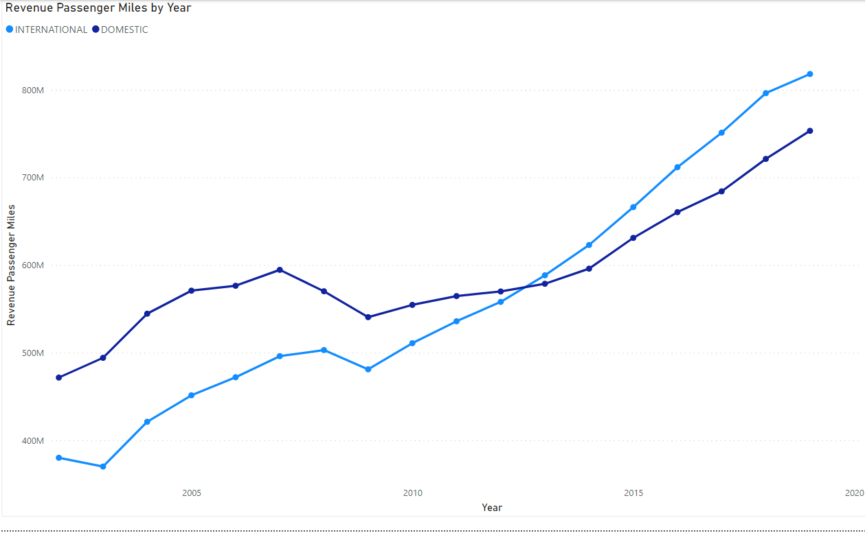
Revenue Passenger Miles – US Airlines (2000 – 2019)

Slide 12
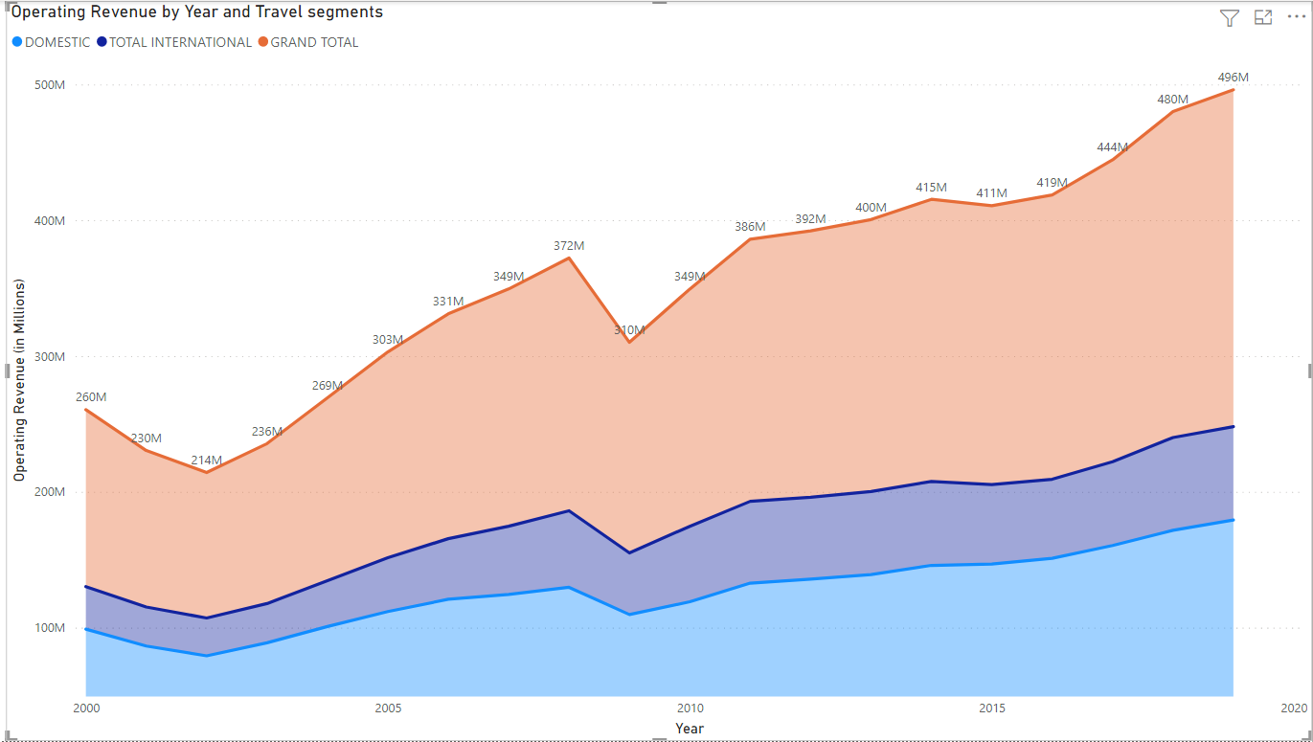
Operating Revenue – US Airlines (2000 – 2019)

Slide 13
Conclusion : Air Travel is Safe
The information highlights the higher safety in Air travel as compared to Road travel – when it comes to total fatalities or the fatality rate per 100 million miles of travel
US Fatalities data for the different modes of Travel indicates Air Travel is the safest amongst all
World Airline Data Confirms huge decreases in the fatalities counts, which is accompanied by reduction in adverse incidents and fatal incidents
The World-wide airline traffic is steadily increasing at the same time
The increase in Airline operations is reflected in the sizeable increases in the Revenue Passenger Miles and Operating Revenues over the years

Slide 14
References
fivethirtyeight/data. (n.d.). GitHub. https://github.com/fivethirtyeight/data/tree/master/airline-safety
Fatality Analysis Reporting System (FARS), FHTSA. https://www-fars.nhtsa.dot.gov/Trends/TrendsGeneral.aspx
https://www.bts.gov/content/us-air-carrier-safety-data
https://www.airlines.org/dataset/world-airlines-traffic-and-capacity-2/
https://www.bts.gov/content/transportation-fatalities-mode
https://www.transtats.bts.gov/Data_Elements.aspx?Qn6n=G

Slide 15

BON VOYAGE

